Slide 1
Introduction to Windowing Functions John Deardurff

Slide 2
What does this session cover?
Using Ranking Functions
What are Windowing Functions?
Windowing Components
Using Aggregate Functions
LAG and LEAD Functions
Notes:
This post will describe how a SQL Server will PROCESS a query. The first time through running an Ad Hoc query or Stored Procedure, SQL Server will go through each of the following steps.
The first step is to Parse the statement into keywords, expressions, and operators. This is where the syntax of your query statement is checked for accuracy. Both the first and second steps are where you will find syntax errors. In most cases, these errors are caused by misspellings or putting commas in the wrong place.
The second step is to Resolve object names (Tables, Views, Columns, etc.) to see if they exist. This step also resolves aliases of columns and tables, as well as, resolves data types and performs implicit data type conversions. This is also where user permissions are checked and if any cached plans exist. As a side note, if you read other blog posts, this step is technically called the Binding phase. I personally call this step the Resolving phase to help spell the word PROCESS as a memorization tool and also to fit the steps on a single slide during presentations.
The third step is to Optimize the query. This is where the query optimizer will find different ways of locating data from your tables based on available indexes and/or statistics. Once it figures a good enough plan to retrieve your result set using the least amount of resources, it will create an Execution Plan. Errors would only occur during this stage if there is a lack of hardware resources. Most compile errors happen at the next step.
The fourth step is to Compile the Execution Plan and store it in the Procedure Cache for future use.
Finally, the Execution Plan is passed to the Storage Engine to Execute the query and hopefully return the desired SQL Sets. This is where Run-Time errors will occur that need to be managed by using Exception Handling. (SQL Sets are normally called recordsets or rowsets, but I’m making a blog post on the PROCESS of queries not the PBOCERS of queries).
Additional submissions of the query from a Stored Procedure, will check the Procedure Cache for existing or similar Execution Plans that could be re-used for the query. If this is the case, the existing Execution Plan will be used to retrieve the SQL Sets using the Execution Context of the Stored Procedure.
It is possible for an Ad Hoc query to also re-use an existing plan from the procedure cache if the only thing that has changed in the query is the parameter value. Example: If a query had been written WHERE ProductID = 732 and was re-written WHERE ProductID = 738 the execution plan could be re-used, but if anything else changed, even by adding a space, the optimizer would compile a new execution plan.
One final thing. You will notice that you can have both an Estimated Execution Plan and an Actual Execution Plan. The difference is the first will show you what the plan would look like before the plan is compiled and the second will additionally add the values of actually running the plan that was placed in the procedure cache and executed.

Slide 3
What are Windowing Functions?
Windowing Functions
Performs calculations across a set of rows that are related to the current row.
Like regular aggregate functions but will not group records together.
Allows detailed information to be side-by-side with aggregate data.
Windowing functions can’t be used with standard aggregate functions or the GROUP BY clause.
Notes:
Operations within TempDB are minimally logged so that transactions can be rolled back. TempDB is re-created every time SQL Server is started so that the system always starts with a clean copy of the database. Temporary tables and stored procedures are dropped automatically on disconnect, and no connections are active when the system is shut down. Therefore, there is never anything in TempDB to be saved from one session of SQL Server to another. Backup and restore operations are not allowed on TempDB.
TempDB Database
From <https://docs.microsoft.com/en-us/sql/relational-databases/databases/tempdb-database?view=sql-server-ver15#memory-optimized-tempdb-metadata>

Slide 4
Key Windowing Syntax Components
Order By
Sorts the data window in either Ascending (Default) or Descending order.
Partition By
Splits the window into frames.
Rows Between
Specifies the rows to calculate inside window frames in relation to the current row.
Over ()
Defines the data window for calculations.
Notes:
Operations within TempDB are minimally logged so that transactions can be rolled back. TempDB is re-created every time SQL Server is started so that the system always starts with a clean copy of the database. Temporary tables and stored procedures are dropped automatically on disconnect, and no connections are active when the system is shut down. Therefore, there is never anything in TempDB to be saved from one session of SQL Server to another. Backup and restore operations are not allowed on TempDB.
TempDB Database
From <https://docs.microsoft.com/en-us/sql/relational-databases/databases/tempdb-database?view=sql-server-ver15#memory-optimized-tempdb-metadata>

Slide 5
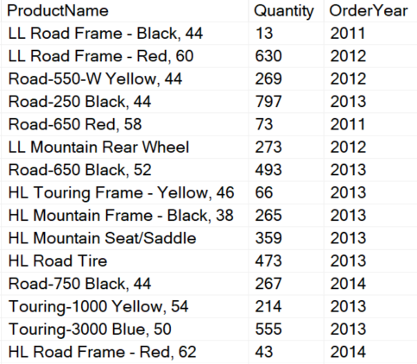
Demonstration Setup for Windowing Functions
CREATE OR ALTER VIEW Sales.Product_Sales_By_Year
AS
SELECT P.Name AS ProductName,
SUM(SOD.OrderQty) AS Quantity,
YEAR(OrderDate) AS OrderYear
FROM Production.Product AS P
JOIN Sales.SalesOrderDetail AS SOD
ON P.ProductID = SOD.ProductID
JOIN Sales.SalesOrderHeader AS SOH
ON SOH.SalesOrderID = SOD.SalesOrderID
GROUP BY P.Name, YEAR(OrderDate);
GO

Slide 6

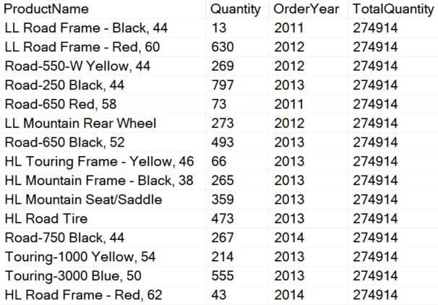
Windowing Component: OVER()
Result set (OVER)
SELECT ProductName, Quantity, OrderYear,
SUM(Quantity) OVER() AS TotalQuantity
FROM Sales.Product_Sales_By_Year
Notes:
The result set is the window of rows defined by the OVER clause. If there is no partition, then the window includes all rows. If a partition element is defined in the OVER clause, the conceptual subset of rows is called the window partition. If a frame is defined, the window is further restricted to the starting and ending boundaries defined by the frame.
20461D
13: Using Window Ranking, Offset, and Aggregate Functions

Slide 7
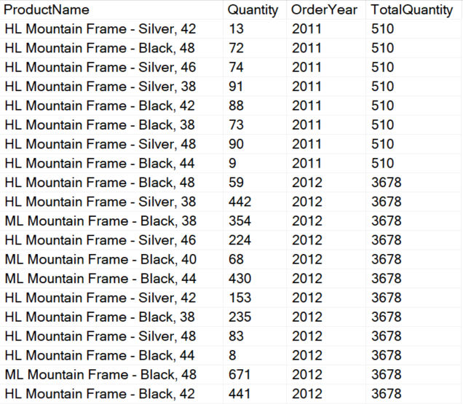
Windowing Component: ORDER BY
Result set (OVER)
SELECT ProductName, Quantity, OrderYear,
SUM(Quantity) OVER(ORDER BY OrderYear) AS TotalQuantity
FROM Sales.Product_Sales_By_Year
WHERE ProductName LIKE '%Mountain Frame%'
(Sorted by Order Year)
Notes:
The result set is the window of rows defined by the OVER clause. If there is no partition, then the window includes all rows. If a partition element is defined in the OVER clause, the conceptual subset of rows is called the window partition. If a frame is defined, the window is further restricted to the starting and ending boundaries defined by the frame.
20461D
13: Using Window Ranking, Offset, and Aggregate Functions

Slide 8
Windowing Component: ORDER BY
Result set (OVER)
SELECT ProductName, Quantity, OrderYear,
SUM(Quantity) OVER(ORDER BY OrderYear) AS TotalQuantity
FROM Sales.Product_Sales_By_Year
WHERE ProductName LIKE '%Mountain Frame%'
(Sorted by Order Year)
Notes:
The result set is the window of rows defined by the OVER clause. If there is no partition, then the window includes all rows. If a partition element is defined in the OVER clause, the conceptual subset of rows is called the window partition. If a frame is defined, the window is further restricted to the starting and ending boundaries defined by the frame.
20461D
13: Using Window Ranking, Offset, and Aggregate Functions

Slide 9
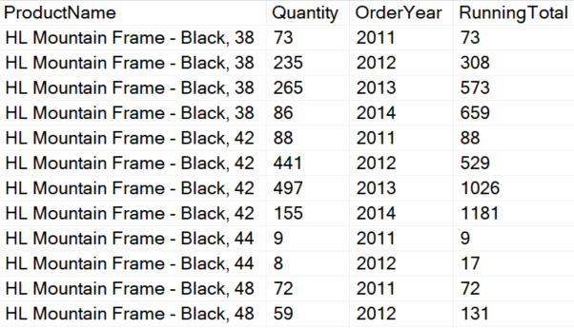
Windowing Component: PARTITION BY
Result set (OVER)
SELECT ProductName, Quantity, OrderYear,
SUM(Quantity) OVER(
PARTITION BY ProductName
ORDER BY OrderYear
) AS RunningTotal
FROM Sales.Product_Sales_By_Year
WHERE ProductName LIKE '%Mountain Frame%'
Notes:
The result set is the window of rows defined by the OVER clause. If there is no partition, then the window includes all rows. If a partition element is defined in the OVER clause, the conceptual subset of rows is called the window partition. If a frame is defined, the window is further restricted to the starting and ending boundaries defined by the frame.
20461D
13: Using Window Ranking, Offset, and Aggregate Functions

Slide 10
Windowing Component: PARTITION BY
Result set (OVER)
SELECT ProductName, Quantity, OrderYear,
SUM(Quantity) OVER(
PARTITION BY ProductName
ORDER BY OrderYear
) AS RunningTotal
FROM Sales.Product_Sales_By_Year
WHERE ProductName LIKE '%Mountain Frame%'
Notes:
The result set is the window of rows defined by the OVER clause. If there is no partition, then the window includes all rows. If a partition element is defined in the OVER clause, the conceptual subset of rows is called the window partition. If a frame is defined, the window is further restricted to the starting and ending boundaries defined by the frame.
20461D
13: Using Window Ranking, Offset, and Aggregate Functions

Slide 11
Windowing Component: PARTITION BY
Result set (OVER)
SELECT ProductName, Quantity, OrderYear,
SUM(Quantity) OVER(
PARTITION BY ProductName
ORDER BY OrderYear
) AS RunningTotal
FROM Sales.Product_Sales_By_Year
WHERE ProductName LIKE '%Mountain Frame%'
Notes:
The result set is the window of rows defined by the OVER clause. If there is no partition, then the window includes all rows. If a partition element is defined in the OVER clause, the conceptual subset of rows is called the window partition. If a frame is defined, the window is further restricted to the starting and ending boundaries defined by the frame.
20461D
13: Using Window Ranking, Offset, and Aggregate Functions

Slide 12
Windowing Component: PARTITION BY
Result set (OVER)
SELECT ProductName, Quantity, OrderYear,
SUM(Quantity) OVER(
PARTITION BY ProductName
ORDER BY OrderYear
) AS RunningTotal
FROM Sales.Product_Sales_By_Year
WHERE ProductName LIKE '%Mountain Frame%'
Notes:
The result set is the window of rows defined by the OVER clause. If there is no partition, then the window includes all rows. If a partition element is defined in the OVER clause, the conceptual subset of rows is called the window partition. If a frame is defined, the window is further restricted to the starting and ending boundaries defined by the frame.
20461D
13: Using Window Ranking, Offset, and Aggregate Functions

Slide 13
Windowing Component: ROWS BETWEEN
Result set (OVER)
SELECT ProductName, Quantity, OrderYear,
SUM(Quantity) OVER(
PARTITION BY ProductName
ORDER BY OrderYear
ROWS BETWEEN UNBOUNDED PRECEDING and CURRENT ROW) AS RunningTotal
FROM Sales.Product_Sales_By_Year
WHERE ProductName LIKE '%Mountain Frame%'
Notes:
The result set is the window of rows defined by the OVER clause. If there is no partition, then the window includes all rows. If a partition element is defined in the OVER clause, the conceptual subset of rows is called the window partition. If a frame is defined, the window is further restricted to the starting and ending boundaries defined by the frame.
20461D
13: Using Window Ranking, Offset, and Aggregate Functions

Slide 14
Row Between Clause
Rows Between
Specifies the rows to calculate inside window frames in relation to the current row.
ROWS BETWEEN lower_bound AND upper_bound
UNBOUNDED PRECEDING – All rows before the current row.
N PRECEDING – N rows before the current row.
CURRENT ROW – Just the current row.
N FOLLOWING – N rows after the current row.
UNBOUNDED FOLLOWING – All rows after the current row
The bounds can be any of these five options:
Notes:
Operations within TempDB are minimally logged so that transactions can be rolled back. TempDB is re-created every time SQL Server is started so that the system always starts with a clean copy of the database. Temporary tables and stored procedures are dropped automatically on disconnect, and no connections are active when the system is shut down. Therefore, there is never anything in TempDB to be saved from one session of SQL Server to another. Backup and restore operations are not allowed on TempDB.
TempDB Database
From <https://docs.microsoft.com/en-us/sql/relational-databases/databases/tempdb-database?view=sql-server-ver15#memory-optimized-tempdb-metadata>

Slide 15
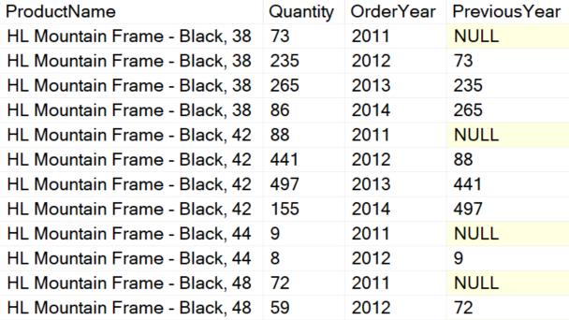
LAG Windowing Function
Result set (OVER)
SELECT ProductName, Quantity, OrderYear,
LAG(Quantity, 1) OVER(
PARTITION BY ProductName
ORDER BY OrderYear) AS PreviousYear
FROM Sales.Product_Sales_By_Year
WHERE ProductName LIKE '%Mountain Frame%'
Notes:
The result set is the window of rows defined by the OVER clause. If there is no partition, then the window includes all rows. If a partition element is defined in the OVER clause, the conceptual subset of rows is called the window partition. If a frame is defined, the window is further restricted to the starting and ending boundaries defined by the frame.
20461D
13: Using Window Ranking, Offset, and Aggregate Functions

Slide 16
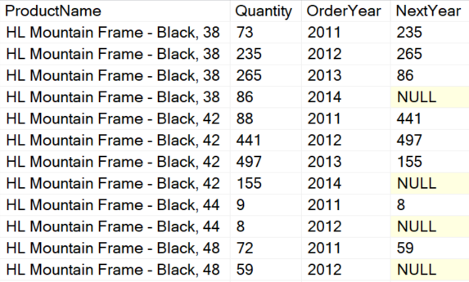
LEAD Windowing Function
Result set (OVER)
SELECT ProductName, Quantity, OrderYear,
LEAD(Quantity, 1) OVER(
PARTITION BY ProductName
ORDER BY OrderYear) AS NextYear
FROM Sales.Product_Sales_By_Year
WHERE ProductName LIKE '%Mountain Frame%'
Notes:
The result set is the window of rows defined by the OVER clause. If there is no partition, then the window includes all rows. If a partition element is defined in the OVER clause, the conceptual subset of rows is called the window partition. If a frame is defined, the window is further restricted to the starting and ending boundaries defined by the frame.
20461D
13: Using Window Ranking, Offset, and Aggregate Functions

Slide 17
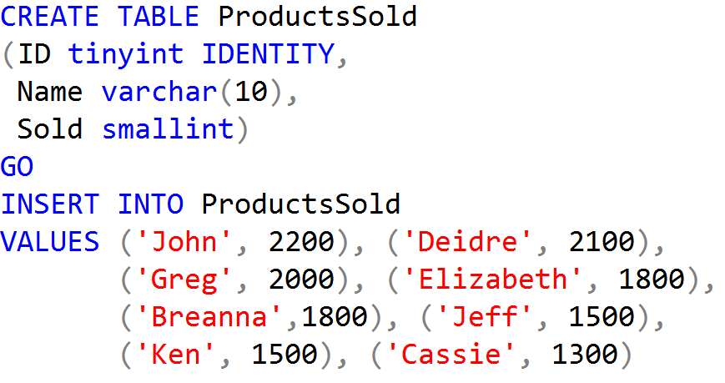
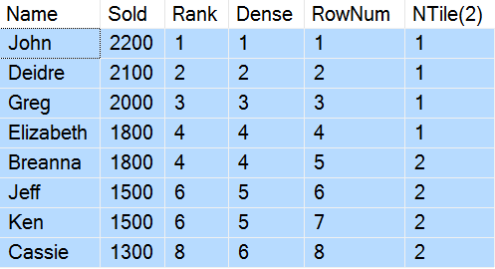
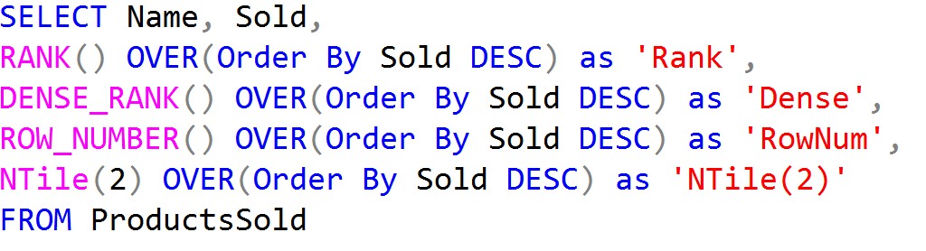
Ranking Functions Example

Slide 18


